Slide 1
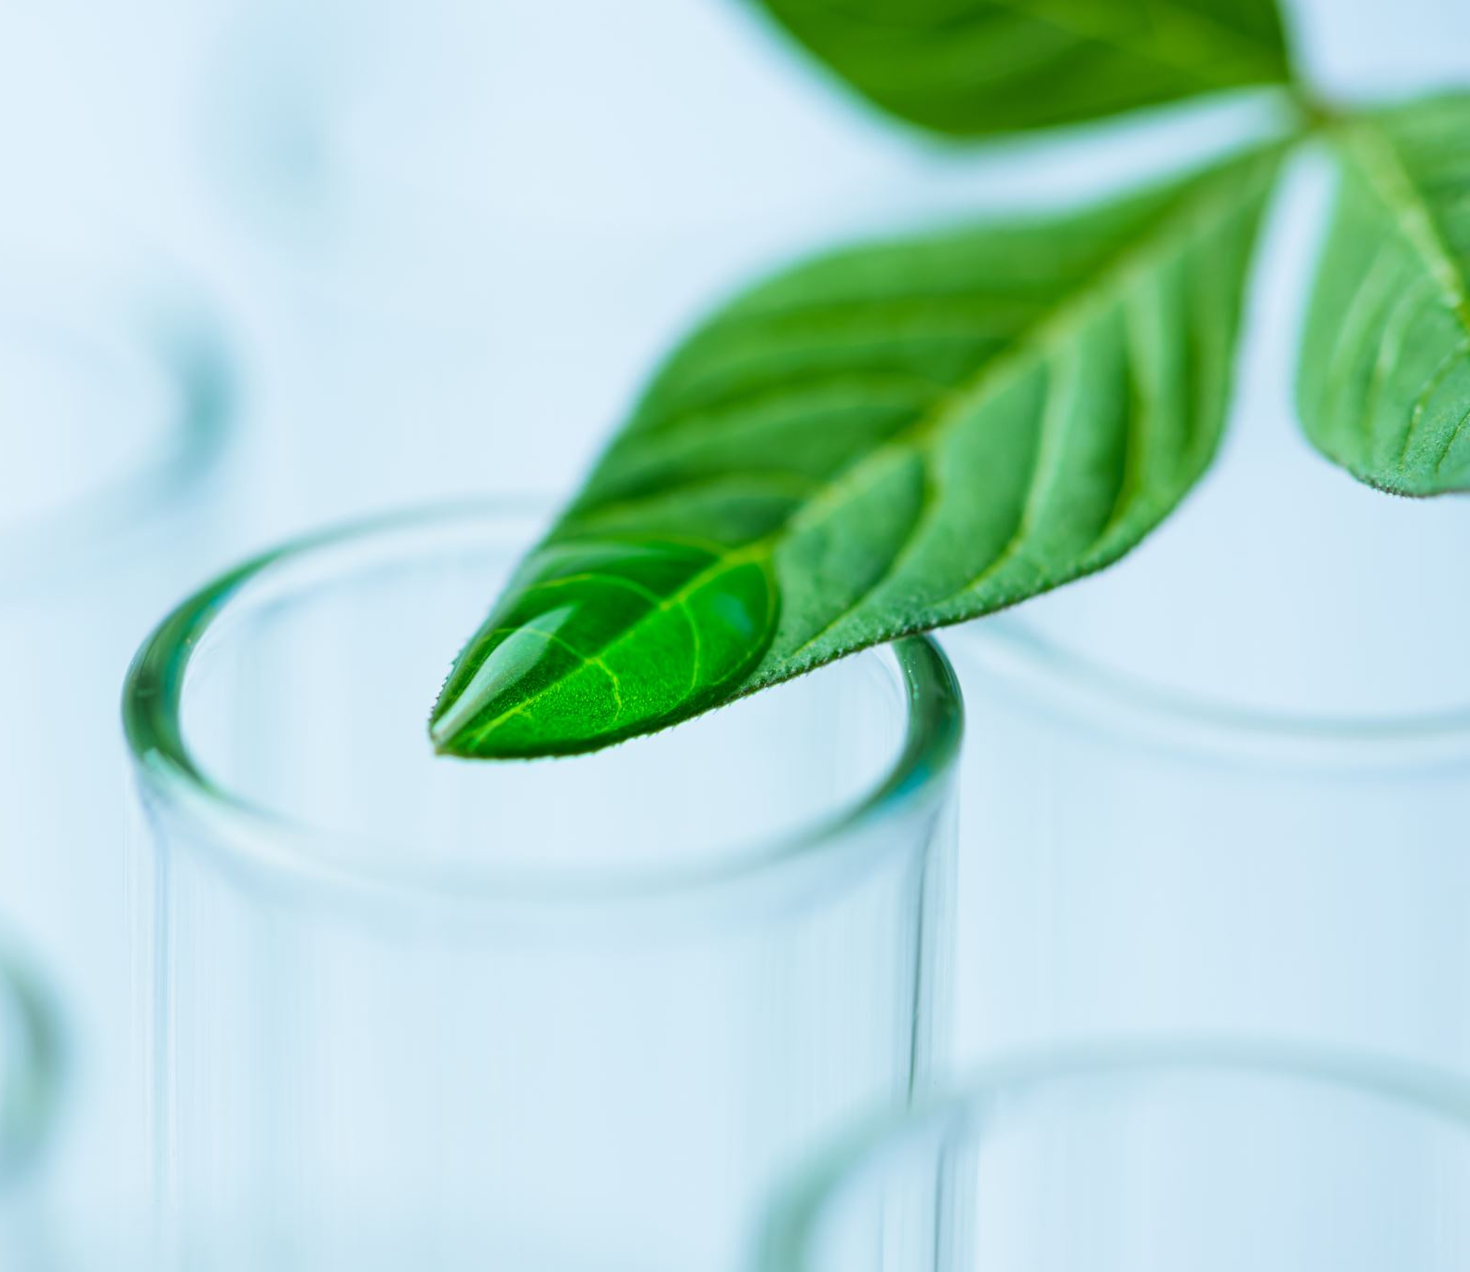
Precision Agriculture
Reverse Engineering of IoT Systems

Slide 2
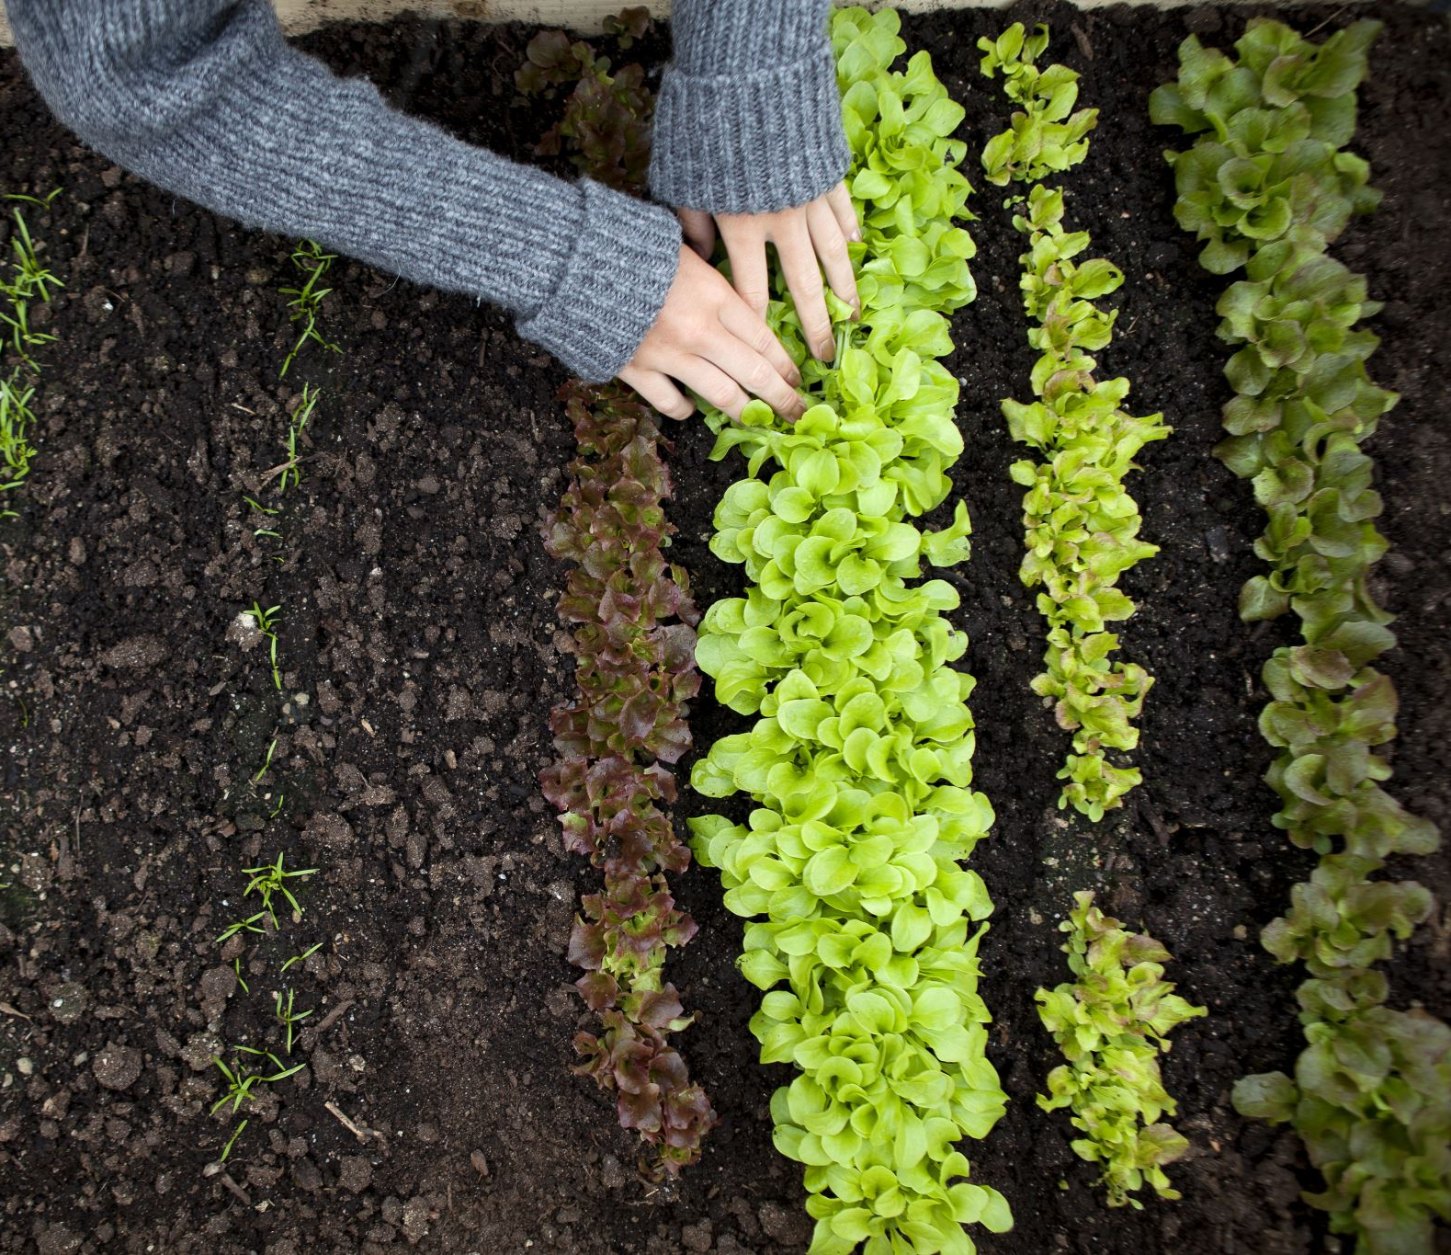
What is sustainable agriculture?
Meeting our societal food production needs without compromising the ability for future generations to meet their needs.
Every individual has a part to play in contributing to sustainable agriculture. This includes farmers, laborers, policymakers, researchers, retailers and consumers.

Slide 3
Agricultural Revolutions
1900–1930
Mechanized Agriculture
Each farmer was able to feed about 26 people.
1950 – 1960
Green Revolution
Each farmer was able to feed about 156 people.
2050
Precision Agriculture
Projected global population: 9.6 Billion
Each farmer will be able to feed about 265 people.

Slide 4
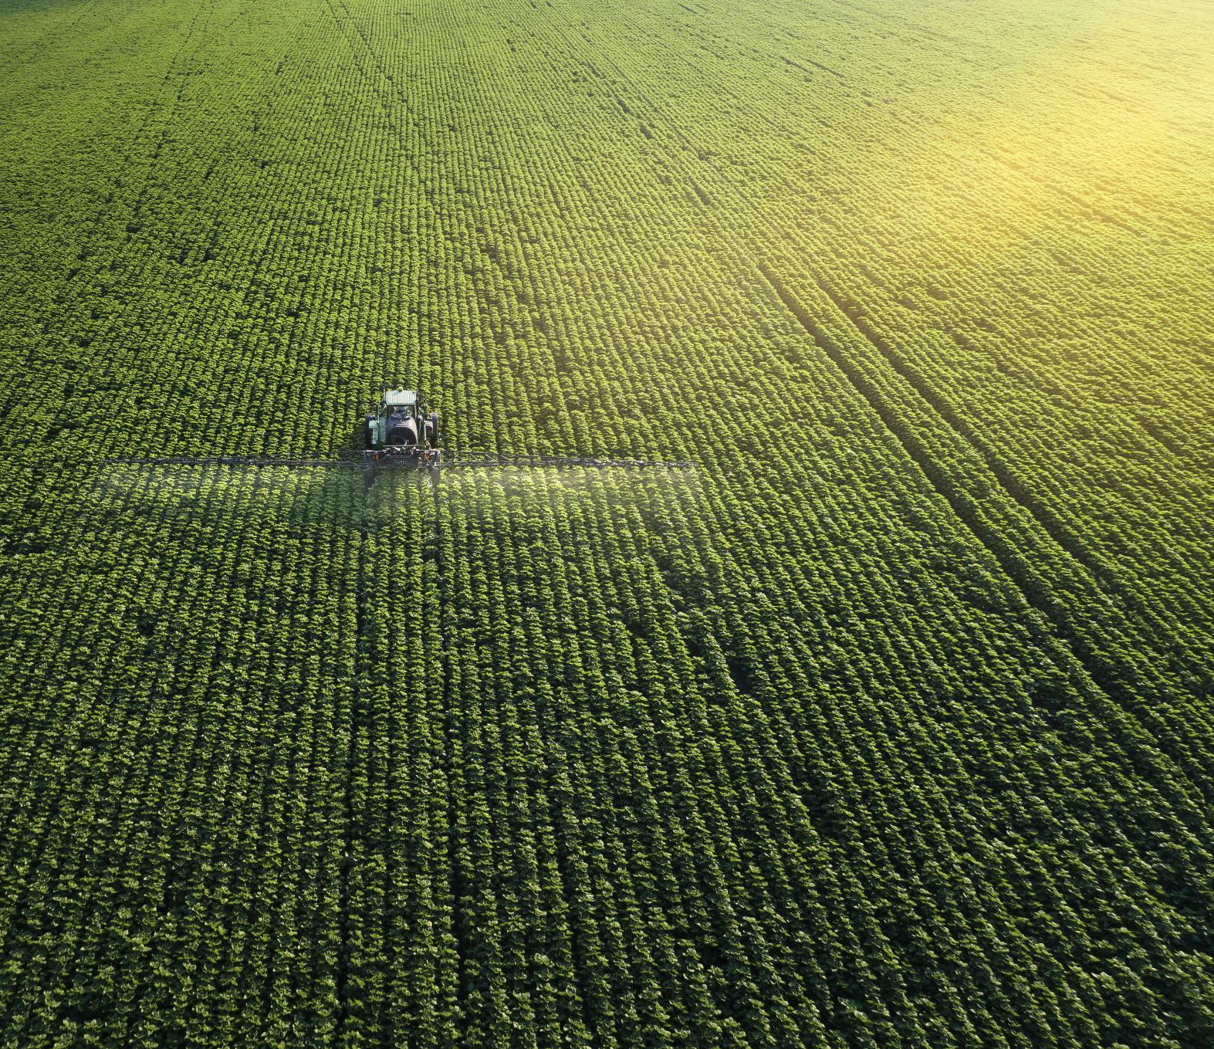
What is precision agriculture?
Precision agriculture is the design and implementation of IoT devices into the farming industry.
The best part about precision agriculture is that it is revolutionizing our world. We are approaching one of the greatest advancements in human history.
Through precision agriculture, the possibility exists where world hunger could be solved by 2050.
The data that is collected from the IoT devices we use is helping drive precision agriculture forward.

Slide 5
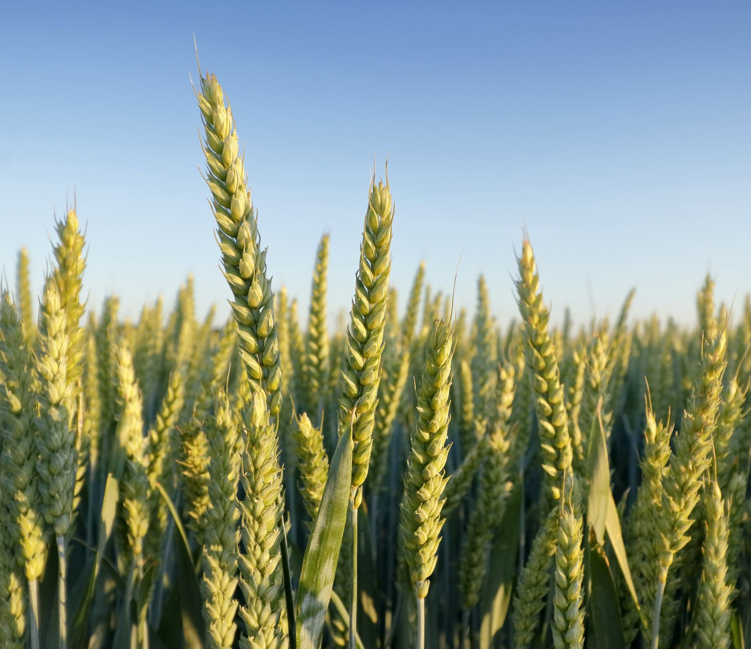
What kind of data is collected?
There are many important data values and readings we collect in relation to crops.
Collected data can include :
Air Temperature
Air Humidity
Soil Moisture
Luminosity
GPS Coordinates
Soil Temperature
Plant Temperature
Plant Width
Plant Diameter

Slide 6
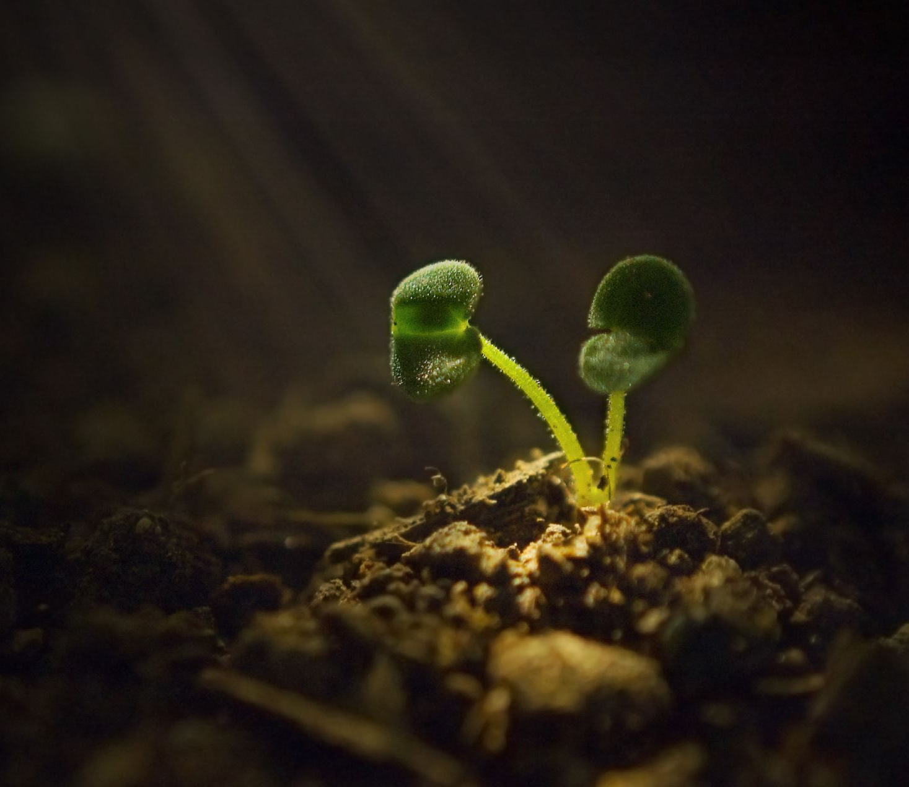
How is the data used?
Data that is collected is use to monitor plant health.
We are able to tell if a plant needs things such as:
Water
Sunlight
Fertilizer
Pesticides
Increase/Decrease in humidity
Increase/Decrease in temperature
When a plant is in need of care, IoT devices are able to alert farmers to specific needs for their crops.

Slide 7
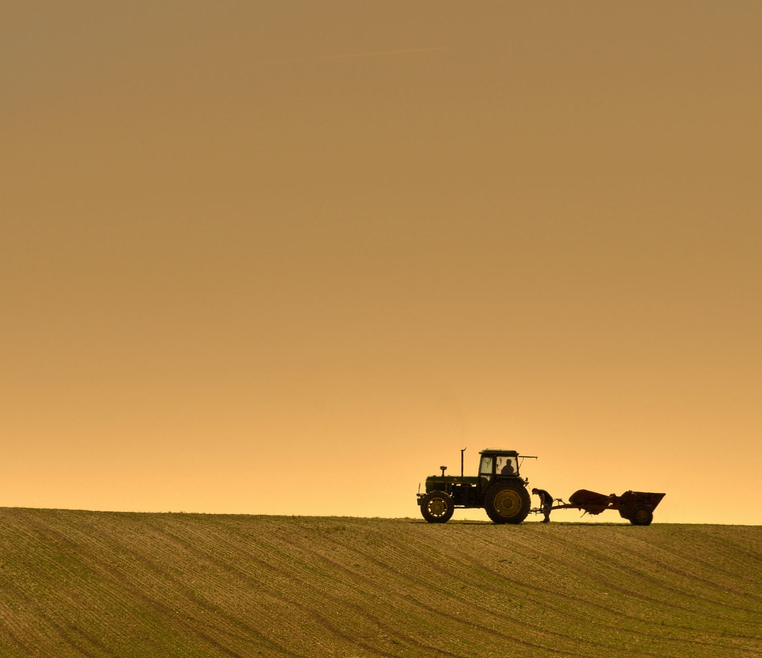
How Resources are Effectively Managed
One of the most fundamentally important aspects of precision agriculture is GPS.
While all data collected is important, GPS coordinates allow farmers to identify precise locations in their land that need specific attention.
This allows farmers to effectively farm their fields. They do not need to spend unnecessary resources on crops that are not in need of care.
Instead of spraying an entire crop field with pesticides, a farmer can spray a specific section that is in need of pest control.

Slide 8
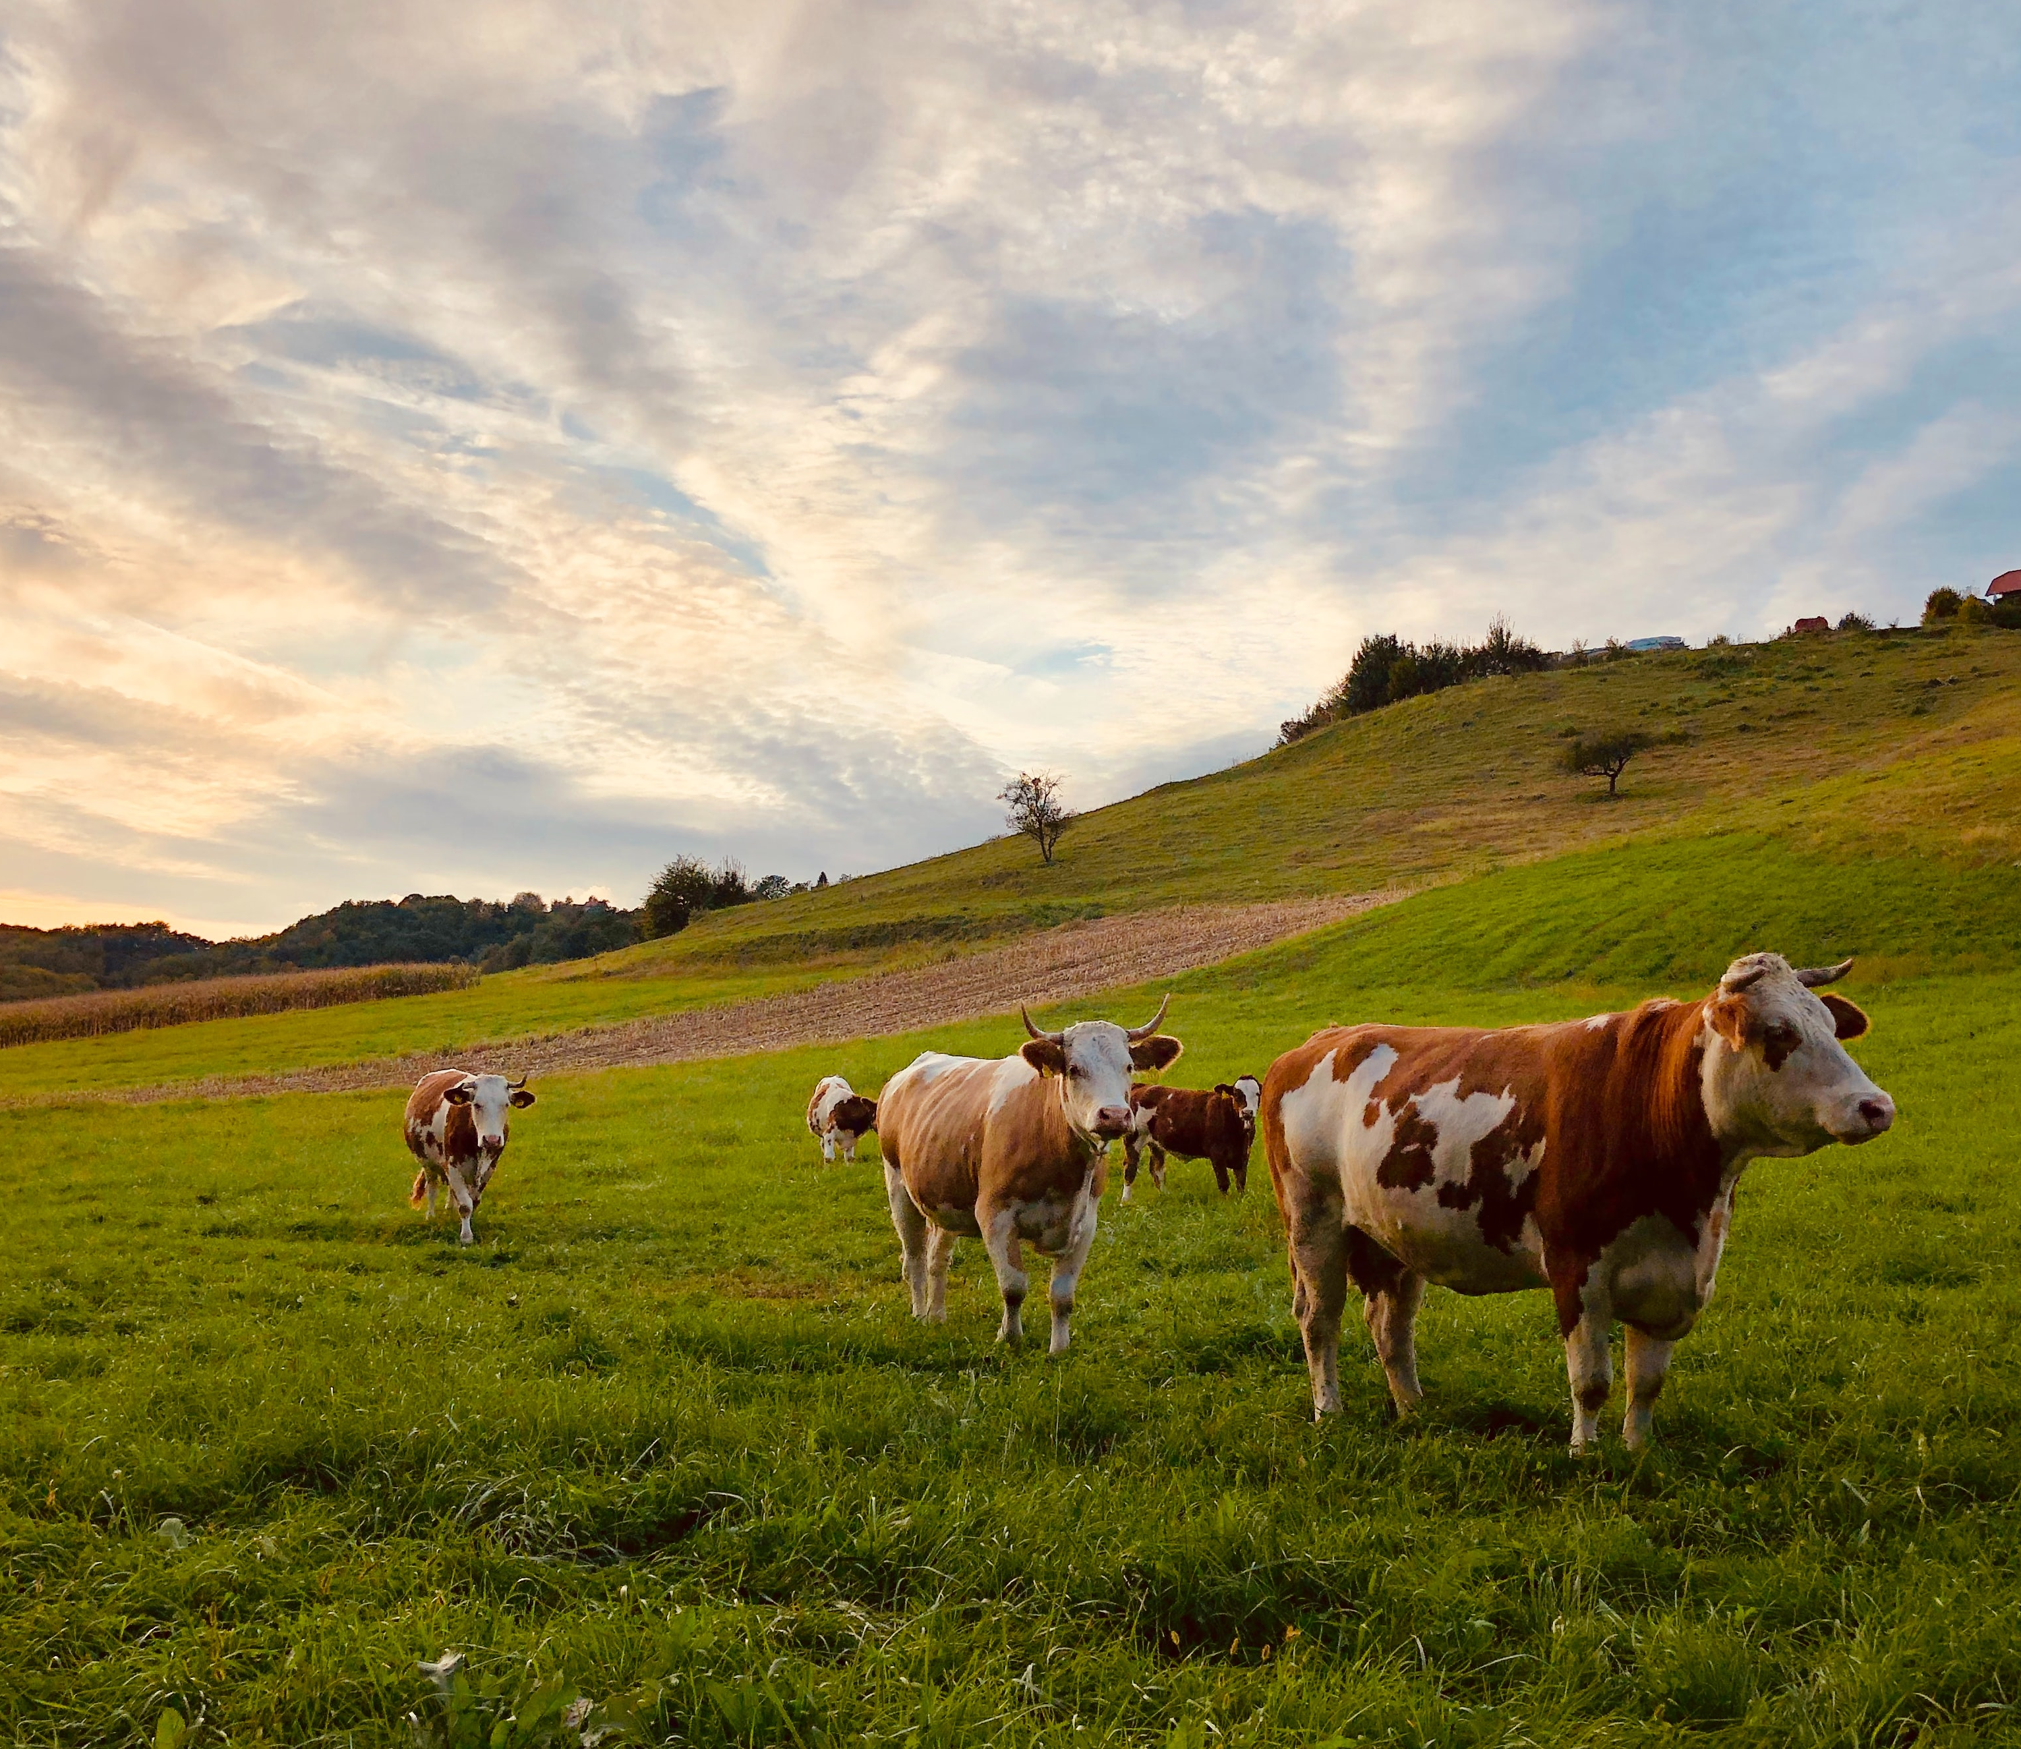
Innovations in Livestock
Internet of Things devices can also be used for livestock.
Cattle can be outfitted with internal sensors to monitor stomach acidity to provide indicators of digestive problems.
Movement patterns of cattle can be monitored to provide information on health, fitness and physical injuries.
Data collected from these sensors can be used to detect trends and patterns.

Slide 9
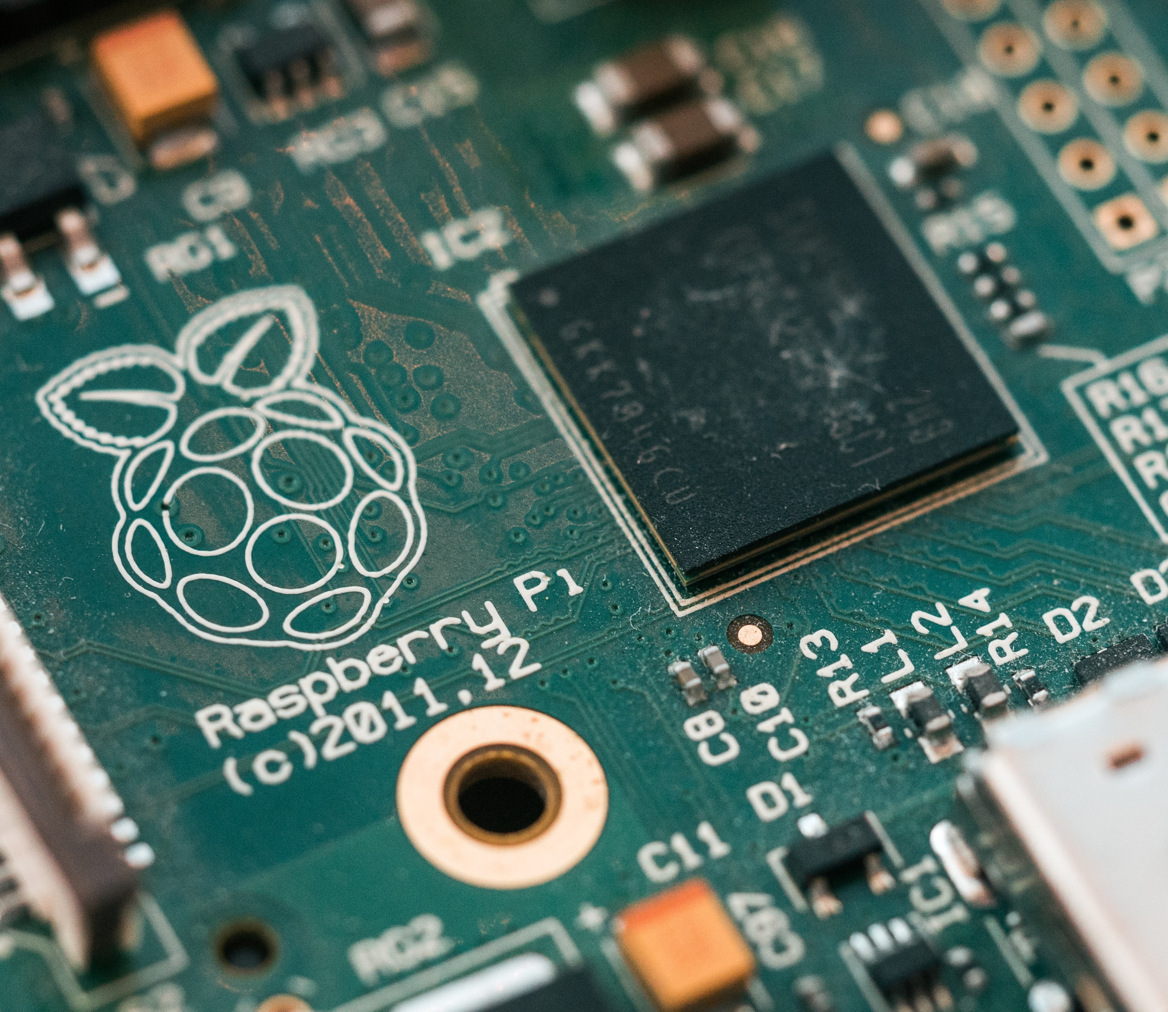
Building a Precision Agriculture Device
We have created our own precision agriculture device. It is designed on a small scale but can be developed further.
The modules we have used include:
Humidity Sensor
Temperature Sensor
Soil Moisture Sensor
Luminosity Sensor

Slide 10
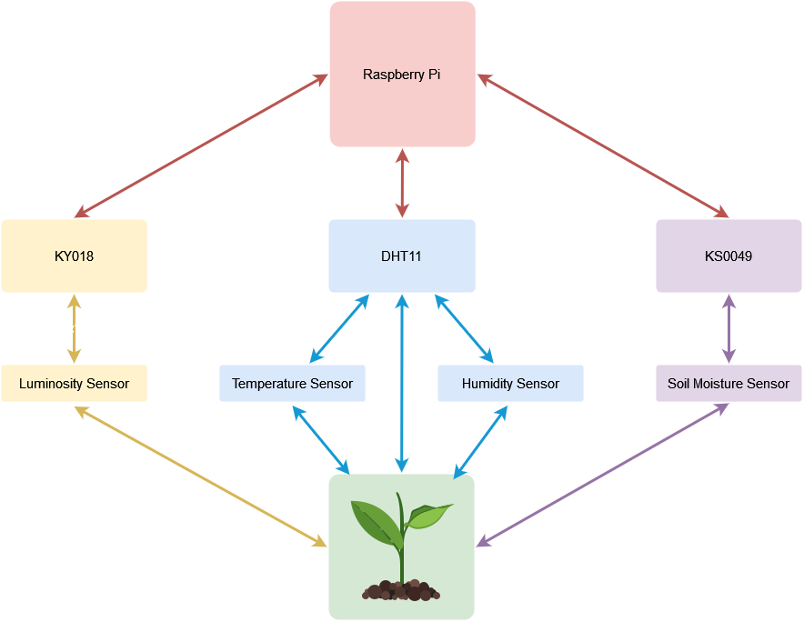


Slide 11
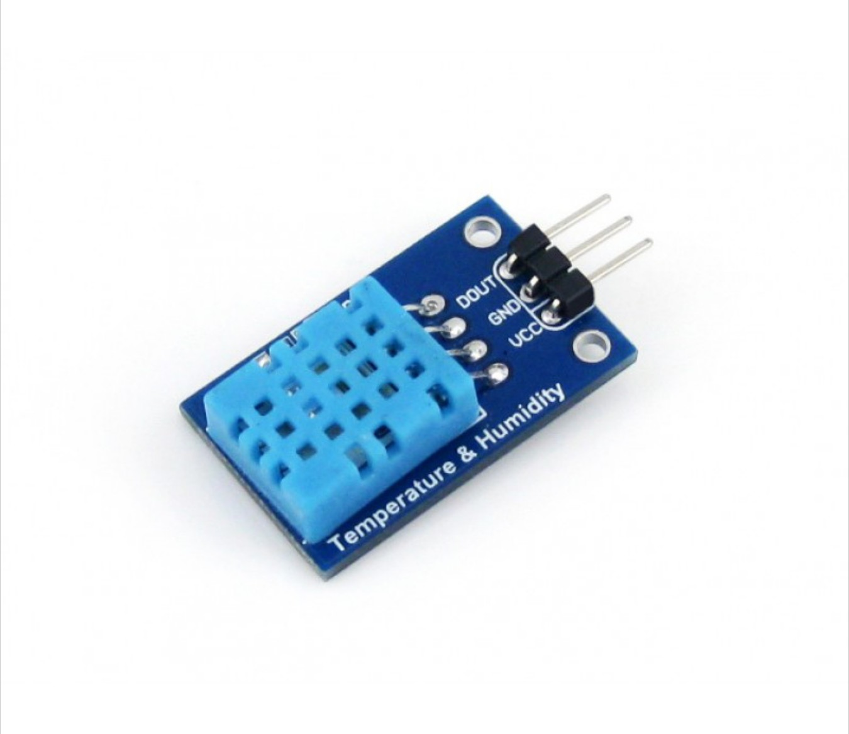
Temperature Sensor
To measure temperature, the dht11 device uses a coefficient thermistor.
A thermistor, also known as a resistance thermometer, is made of metallic oxides pressed into a disk.
The conductivity of the disk is dependent upon the temperature of the disk itself.
When the temperature increases, resistance decreases.

Slide 12
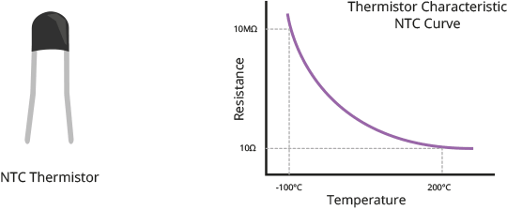

Slide 13
Humidity Sensor
The dht11 humidity sensor uses a hygroscopic dielectric material placed between a pair of electrodes.
This material absorbs water collected from the outside air.
The more water that is absorbed by the dielectric material, the more conductive the sensor becomes.

Slide 14
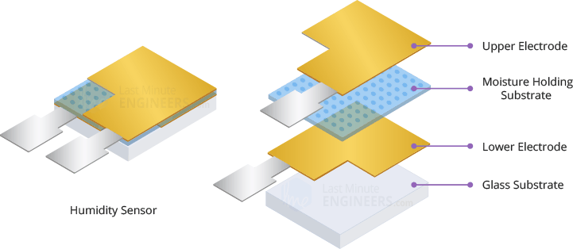

Slide 15
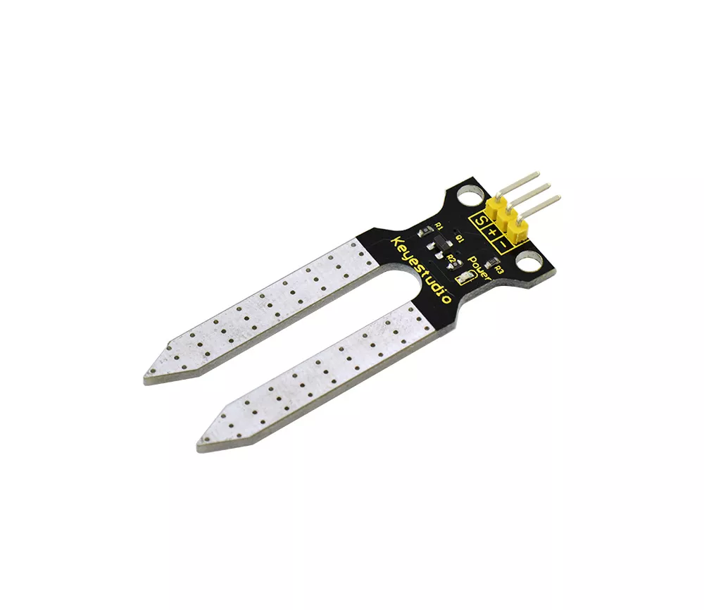
Soil Moisture Sensor
The moisture sensor uses two metallic prongs to measure the conductivity between both points.
The water that rests between the two prongs acts as a conductor.
If the soil is moist, electricity conducts with greater ease.
If the soil is dry, electricity does not conduct as well.

Slide 16
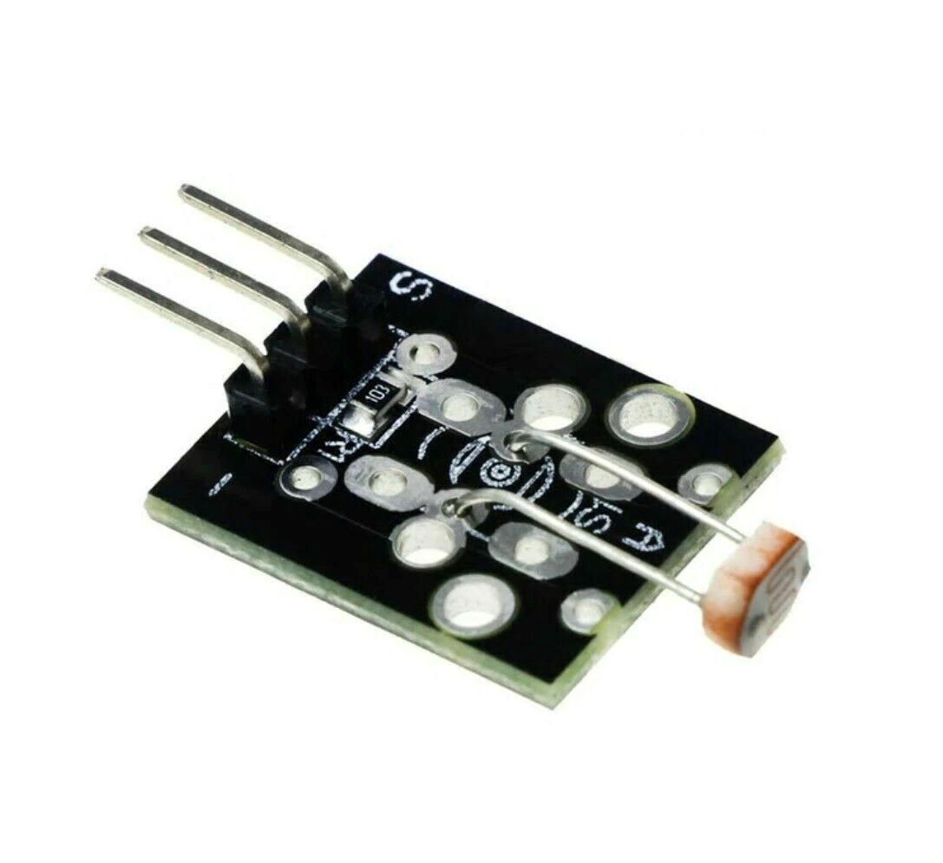
Luminosity Sensor
The luminosity sensor uses a photoresistor.
This photoresistor is made up of a photo-conductor material that is sensitive to light.
When light hits the photo-conductor material, the material absorbs radiation.
Electrons move from the valence band to the conduction band.
The more electrons that are in the reduction band, the less resistance there is.

Slide 17
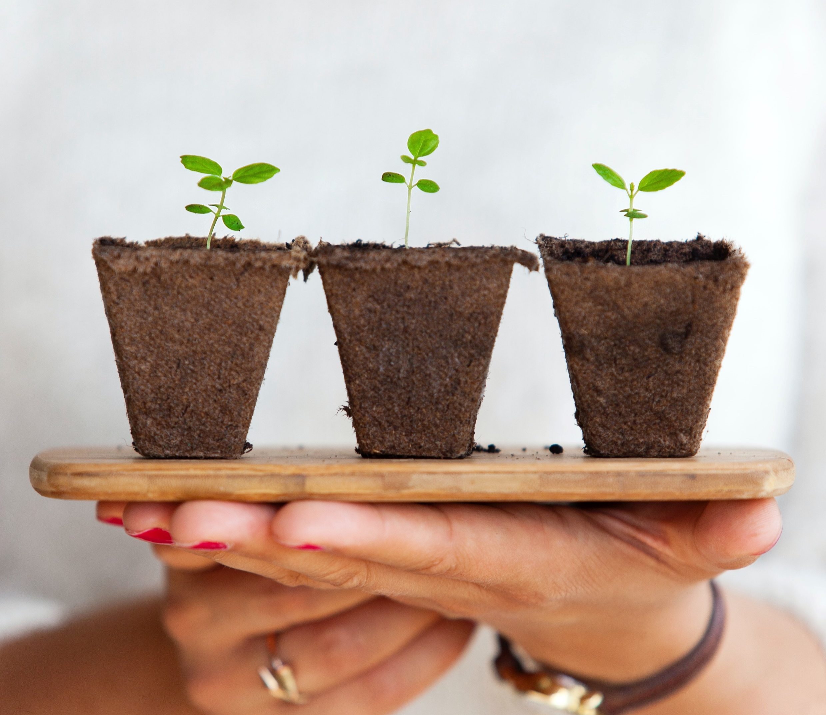
Continuing the Project
Most precision agriculture devices operate on a global positioning system.
The project is currently able to monitor aspects of plant health on a small scale.
Additional features could be installed to obtain other data points such as:
Soil Type
Plant Temperature
Soil Temperature
GPS Coordinates
The next step for this project would be to outfit the plant with an irrigation system.
The irrigation system would water the plant based on the collected data.

Slide 18


Slide 19
Resources:
https://croplife.ca/field-notes-precision-agriculture-canada/
https://www.eetimes.eu/sensors-networks-enable-precision-agriculture/
https://idealog.co.nz/tech/2016/10/five-technologies-changing-agriculture
https://avtech.com.gr/en/precision-agriculture-2/
https://sarep.ucdavis.edu/sustainable-ag
https://lastminuteengineers.com/dht11-dht22-arduino-tutorial/

